Slide 1


Unit 4
Machine Learning

Slide 2
Chapters for Discussion
Chapter - 1
Introduction to Machine Learning
Chapter - 2
Supervised Learning
Chapter - 3
Unsupervised Learning

Slide 3

Chapter
Introduction to Machine Learning
1

Slide 4


DISCLAIMER
The content is curated from online/offline resources and used for educational purpose only.

Slide 5

Learning Objectives
Understand the historical development and current trends in AI and ML, including their impact across various industries.
Explain the significance of AI and ML in promoting sustainability and addressing environmental challenges.
Differentiate between the main types of machine learning: supervised, unsupervised, semi-supervised, and reinforcement learning.
Outline the essential steps in a machine learning workflow, including data collection, preprocessing, model selection, training, evaluation, and deployment.
Import and implement basic ML models using Scikit-Learn, including linear regression, decision trees, and clustering algorithms.
GOAL
Notes:
Lets, discuss about Learning objectives,
Understand the historical development and current trends in AI and ML, including their impact across various industries.
Explain the significance of AI and ML in promoting sustainability and addressing environmental challenges.
Differentiate between the main types of machine learning: supervised, unsupervised, semi-supervised, and reinforcement learning.
Outline the essential steps in a machine learning workflow, including data collection, preprocessing, model selection, training, evaluation, and deployment.
Import and implement basic ML models using Scikit-Learn, including linear regression, decision trees, and clustering algorithms.

Slide 6
Overview of AI and ML
Artificial Intelligence (AI) is the field of computer science focused on creating systems capable of performing tasks that typically require human intelligence. It enables machines to understand, reason, learn, and respond intelligently to various types of inputs. AI systems can simulate human-like cognitive functions such as perception, decision-making, problem-solving, and even creativity
Notes:
Overview of AI-ML
AI-enabled apps and gadgets are able to see and recognize items. They are able to comprehend and react to human words. They are able to pick up new knowledge and skills. They are able to provide consumers and specialists with thorough advice. A self-driving car is a prime example of how they may behave autonomously, negating the requirement for human knowledge or involvement.
However, the majority of AI practitioners and researchers in 2024—as well as the majority of AI-related news stories—are centered on developments in generative AI, or "gen AI," a system that can produce original writing, photos, videos, and other types of material. Understanding machine learning (ML) and deep learning, the technologies that underpin generative AI tools, is crucial to comprehending generative AI in its entirety

Slide 7
Overview of AI and ML
Type of AI
Artificial Intelligence Types,
Narrow AI: AI designed to complete very specific actions; unable to independently learn.
Artificial General Intelligence: AI designed to learn, think and perform at similar levels to humans.
Artificial Superintelligence: AI able to surpass the knowledge and capabilities of humans.
Notes:
Type of AI
Narrow AI
Narrow AI, sometimes referred to as weak AI or artificial narrow intelligence (ANI), refers to AI technologies made to execute extremely specific orders or activities. ANI technologies are designed to support and enhance a single cognitive function; they are unable to learn new skills on their own. To accomplish these predetermined goals, they frequently use neural network techniques and machine learning. Natural language processing, for example, is a form of narrow AI since it can understand and react to voice commands but is unable to carry out other activities. AI virtual assistants, self-driving cars, and picture recognition software are a few instances of narrow AI.
Artificial General Intelligence (AGI)
AI that can learn, understand, and carry out a variety of tasks similarly to humans is referred to as artificial general intelligence (AGI), sometimes known as general AI or strong AI. The creation of computers that can carry out multiple activities and serve as realistic, intelligent helpers to people in daily life is the aim of artificial general intelligence research.
Although it is still in its early stages, technology like supercomputers, quantum hardware, and generative AI models like ChatGPT could lay the foundation for artificial general intelligence.
Artificial Superintelligence
Super AI, often known as artificial superintelligence (ASI), is the stuff of science fiction. It is predicted that if AI reaches the level of general intelligence, it would learn so quickly that its skills and knowledge will surpass even that of humanity.
The foundation of fully self-aware AI and other individualistic robots would be ASI. Its idea is also what gives rise to the "AI takeover" cliché in the media. However, it's just conjecture at this moment.

Slide 8
Overview of AI and ML
Functionality-Based Types of Artificial Intelligence
Functionality based AI types,
Reactive Machine AI: AI capable of responding to external stimuli in real time; unable to build memory or store information for future.
Limited Memory AI: AI that can store knowledge and use it to learn and train for future tasks.
Theory of Mind AI: AI that can sense and respond to human emotions, plus perform the tasks of limited memory machines.
Self-Aware AI: AI that can recognize others’ emotions, plus has sense of self and human-level intelligence; the final stage of AI.
Notes:
Functionality-Based Types of Artificial Intelligence
Reactive Machine AI
Simply put, reactive machines are simply that—reactive. They are not able to store memories, learn from past events, or enhance their functionality via experience, but they can react to demands and duties instantly. Furthermore, only a restricted set of input combinations can cause reactive machines to react. The most basic form of artificial intelligence is reactive machines.
Reactive machines can effectively carry out simple autonomous tasks like removing spam from your email inbox or making product recommendations based on your past purchases. However, reactive AI is unable to carry out more complicated tasks or expand on prior knowledge.
Example, Netflix Recommendation Engine: AI-powered recommendation engines are frequently used by media platforms such as Netflix. These engines analyze user viewing history data to identify and recommend content that users are most likely to watch next.
Limited Memory AI
Limited memory AI has the ability to store historical data and utilize it to forecast future events. This indicates that it actively creates its own little, temporary knowledge base and uses it to carry out tasks.
Deep learning, which mimics how neurons work in the human brain, is the foundation of limited memory AI. This enables a machine to take in information from events and "learn" from them, thereby increasing the precision of its actions.
The vast majority of AI applications nowadays are based on the limited memory paradigm. It can be used in many different contexts, ranging from more complex use cases like self-driving cars to smaller-scale applications like chatbots.
Example, Chatbots and virtual assistants are limited memory artificial intelligence (AI) systems that simulate human speech through deep learning. These systems learn from this data and retain user-specific information when users engage with them more frequently, enabling them to respond in a way that is pertinent and tailored to each individual.
Theory of Mind AI
The idea of artificial intelligence (AI) that is able to sense and understand other people's emotions is known as theory of mind. The phrase, which comes from psychology, refers to people's capacity to read other people's emotions and make predictions about their behavior based on that knowledge. Though it hasn't been fully developed yet, theory of mind represents the next significant advancement in AI.
Example, To demonstrate how a good theory of mind application will transform the technology, Rafael Tena, senior AI researcher at insurance business Acrisure, gave the following example: Because it won't make the same mistakes as a human driver, a self-driving car might outperform one in most situations. However, as a driver, you will naturally know to slow down when you pass your neighbor's driveway if you know that their child frequently plays near the road after school. This is something that an AI car with rudimentary memory wouldn't be able to achieve.
Self-Aware AI
Artificial intelligence with self-awareness is referred to as self-aware AI. One of the ultimate objectives in AI development is self-aware AI, often known as the AI point of singularity, which is the level beyond theory of mind. Since self-aware AI would not only be able to experience other people's emotions but will also have a sense of self, it is believed that once this technology is developed, AI machines will be uncontrollable.
Example, Sophia, a robot created by Hanson Robotics, is arguably the most well-known of these. Sophia's sophisticated use of existing AI technology offers a preview of the possibility for self-aware AI in the future, even though it is not yet self-aware. There is disagreement about whether it is morally acceptable to create sentient AI at all, and the future holds both promise and peril.

Slide 9
Overview of AI and ML
AI Concepts
Machine Learning (ML) and Deep Learning (DL)
Natural Language Processing (NLP)
Computer Vision
Reinforcement Learning (RL)
Generative Models
Explainable AI (XAI)
Notes:
Machine Learning (ML) and Deep Learning (DL)
Machine Learning is a broader field that involves using algorithms to recognize patterns, make predictions, or categorize data based on examples provided. ML includes several learning types:
Supervised Learning, where models are trained on labeled data, meaning each example is tagged with the correct output (e.g., spam or non-spam email classification).
Unsupervised Learning, where models find patterns in unlabeled data (e.g., customer segmentation).
Deep Learning is a specialized subset of ML that leverages neural networks with multiple layers (hence "deep") to model complex patterns in large datasets. Neural networks are inspired by the human brain and are particularly effective at handling unstructured data like images, text, and audio. Deep learning architectures include:
Natural Language Processing (NLP) Natural Language Processing (NLP) is a field of artificial intelligence that focuses on enabling computers to understand, interpret, and respond to human language in a valuable way. NLP combines computational linguistics—drawing from computer science and linguistics—with machine learning and deep learning techniques to bridge the communication gap between humans and machines.
Computer Vision Computer Vision (CV) is a field of artificial intelligence focused on enabling machines to interpret and understand visual data, much like human vision. It involves the automated extraction, analysis, and understanding of useful information from images, videos, and other visual inputs to make decisions or perform actions based on that data.
Reinforcement Learning (RL) Reinforcement Learning (RL) is an area of machine learning where an agent learns to make decisions by interacting with an environment to achieve a specific goal. Unlike supervised learning, where labeled data guides the model, RL relies on feedback in the form of rewards and penalties. The agent’s objective is to maximize cumulative rewards over time, often balancing short-term gains with long-term benefits.
Generative Models Generative models are a type of machine learning model designed to generate new data that resembles the data on which they were trained. Unlike traditional discriminative models, which predict labels or classify data, generative models learn the underlying patterns and distribution of a dataset, allowing them to create new samples similar to the original data.
Explainable AI (XAI) Explainable AI (XAI) refers to methods and techniques that make the decision-making processes of artificial intelligence systems transparent and understandable to humans. As AI technologies, especially those based on machine learning and deep learning, have become increasingly complex, the need for interpretability has grown. XAI addresses the “black box” nature of many AI models, where it can be difficult to ascertain how decisions are made, potentially undermining trust in AI applications.

Slide 10
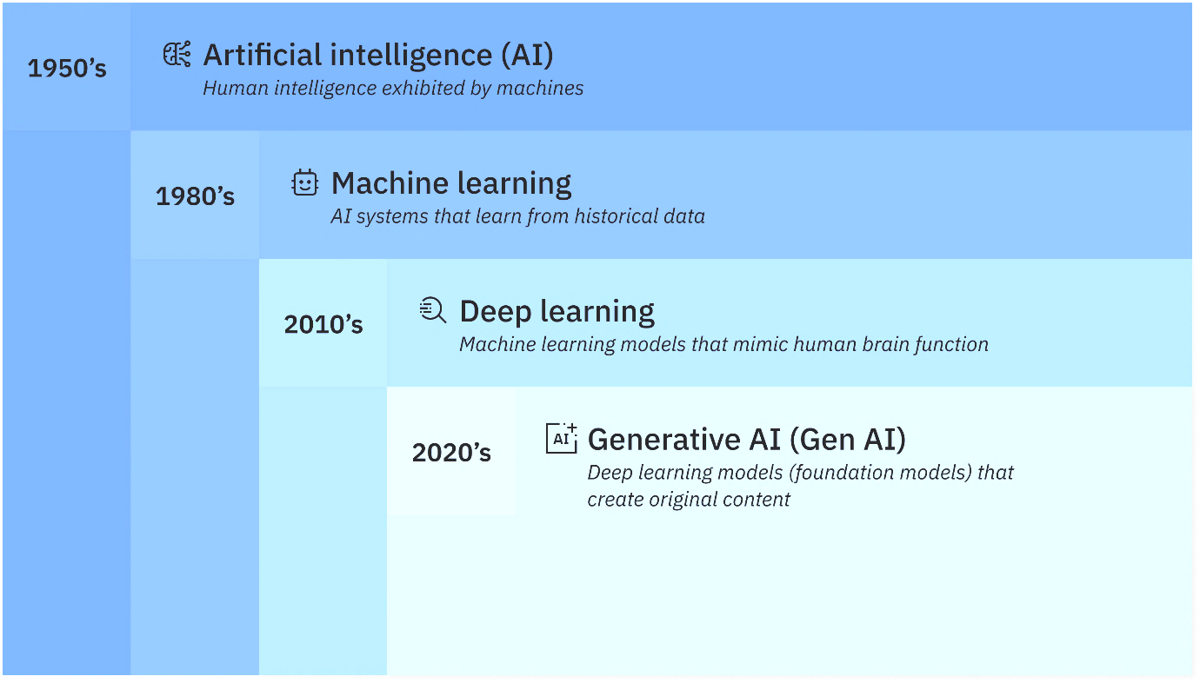
Overview of AI and ML
History of AI
Notes:
History
The concept of AI began in ancient history, with myths and stories of artificial beings possessing intelligence. However, the formal study of AI began in the mid-20th century. In 1956, the Dartmouth Conference, organized by John McCarthy, Marvin Minsky, Nathaniel Rochester, and Claude Shannon, is often considered the birth of AI as a field. Researchers aimed to explore ways to make machines simulate human intelligence.
During the 1960s and 1970s, early AI programs, like ELIZA, a natural language processing program created by Joseph Weizenbaum, showcased the potential for machines to engage in conversation. However, the optimism of this period led to what is known as the "AI winter" in the late 1970s and 1980s, where funding and interest in AI research declined due to unmet expectations and the limitations of early systems.
The resurgence of AI began in the late 1980s and 1990s with the advent of expert systems that used knowledge-based rules to solve specific problems in fields like medicine and finance. The introduction of machine learning techniques in the 1990s allowed computers to learn from data, leading to advancements in speech recognition and computer vision.
The 21st century has seen exponential growth in AI, driven by the availability of large datasets and powerful computing resources. Breakthroughs in deep learning, particularly with neural networks, have revolutionized fields like image and language processing. Today, AI is integrated into everyday applications, from virtual assistants to autonomous vehicles, and continues to evolve rapidly, raising new ethical and societal questions about its impact on the future.

Slide 11
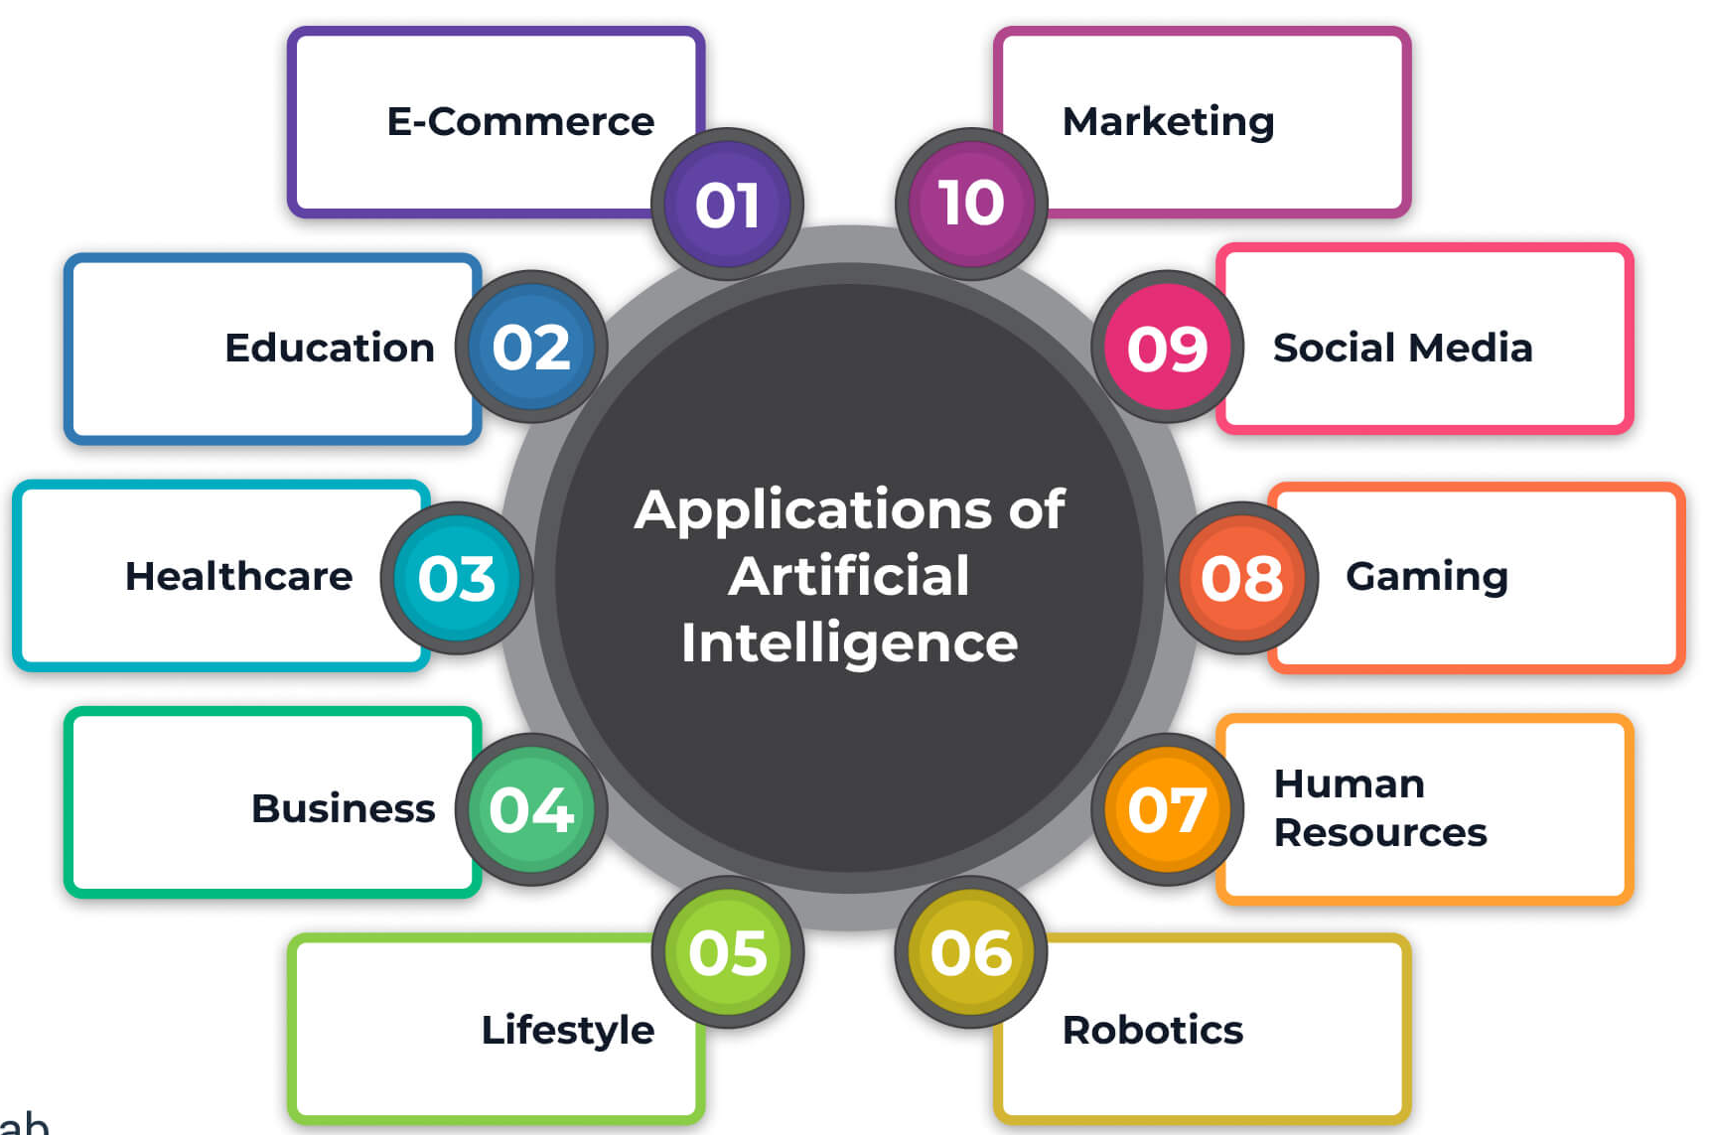
Overview of AI and ML
Application of AI
Image source : https://www.solulab.com/top-artificial-intelligence-applications/
Notes:
Application of AI
Healthcare: AI is revolutionizing patient care through predictive analytics, medical imaging, and personalized medicine. Machine learning algorithms analyze medical data to predict disease outbreaks, assist in diagnostics, and optimize treatment plans, improving patient outcomes and reducing costs.
Finance: In finance, AI algorithms are employed for fraud detection, risk management, and algorithmic trading. AI systems analyze vast amounts of transaction data in real time, identifying patterns indicative of fraud and automating trading decisions based on market trends, leading to more informed investment strategies.
Retail: AI enhances customer experience through personalized recommendations, inventory management, and chatbots. E-commerce platforms utilize AI to analyze consumer behavior, offering tailored product suggestions, while chatbots provide instant customer support, improving engagement and satisfaction.
Manufacturing: AI-driven automation and robotics streamline production processes, reduce downtime, and enhance quality control. Predictive maintenance powered by AI helps anticipate equipment failures, minimizing operational disruptions and extending machinery lifespan.
Transportation: AI underpins the development of autonomous vehicles and smart traffic management systems. Machine learning algorithms process real-time data from sensors and cameras, enabling self-driving cars to navigate safely and efficiently while reducing congestion and accidents.
Education: AI is personalizing learning experiences through adaptive learning technologies. By analyzing student performance data, AI can provide customized educational content and feedback, catering to individual learning needs.
Entertainment: In the entertainment industry, AI algorithms recommend content based on user preferences, improving user engagement on platforms like Netflix and Spotify.

Slide 12
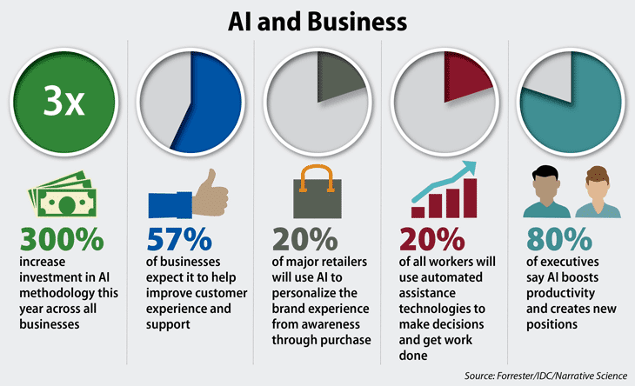
Overview of AI and ML
Jobs Opportunities of AI-ML
Diverse Job Roles
Data Scientist
Machine Learning Engineer
AI Research Scientist
Business Intelligence Analyst
Data Engineer
AI Ethics Specialist
Notes:
Diverse Job Roles
Data Scientist: Analyzes and interprets complex data to help organizations make informed decisions. They employ statistical techniques and machine learning algorithms to derive insights from data.
Machine Learning Engineer: Designs, develops, and implements machine learning models and algorithms. They focus on optimizing model performance and integrating ML solutions into production systems.
AI Research Scientist: Conducts research to advance the field of AI. This role involves developing new algorithms, models, and approaches to solve complex problems.
Business Intelligence Analyst: Uses AI and data analytics tools to interpret data and provide strategic insights for business growth and decision-making.
Data Engineer: Builds and maintains the infrastructure and architecture for data generation, processing, and storage. They ensure data is accessible for analysis.AI Ethics Specialist: Focuses on the ethical implications of AI technologies, ensuring compliance with regulations and promoting responsible AI use.

Slide 13
Overview of AI and ML
Jobs Opportunities of AI-ML - Skill Requirements
To succeed in AI and ML roles, candidates typically need:
Proficiency in programming languages (e.g., Python).
Familiarity with machine learning frameworks (e.g., TensorFlow, Keras, PyTorch) and other basic libraries.
A solid understanding of statistics, data analysis, and data visualization.
Notes:
The AI and ML job market is projected to grow significantly in the coming years. According to various industry reports, the demand for AI professionals is expected to continue rising as organizations seek to leverage AI for competitive advantage and operational efficiency. This growth presents vast opportunities for career advancement, with many companies willing to invest in training and development to build their AI capabilities.
The job opportunities in AI and ML are diverse and expanding rapidly. With the right skills and knowledge, professionals can find fulfilling and rewarding careers across a wide range of industries, contributing to the transformative impact of AI technologies on society and the economy.

Slide 14
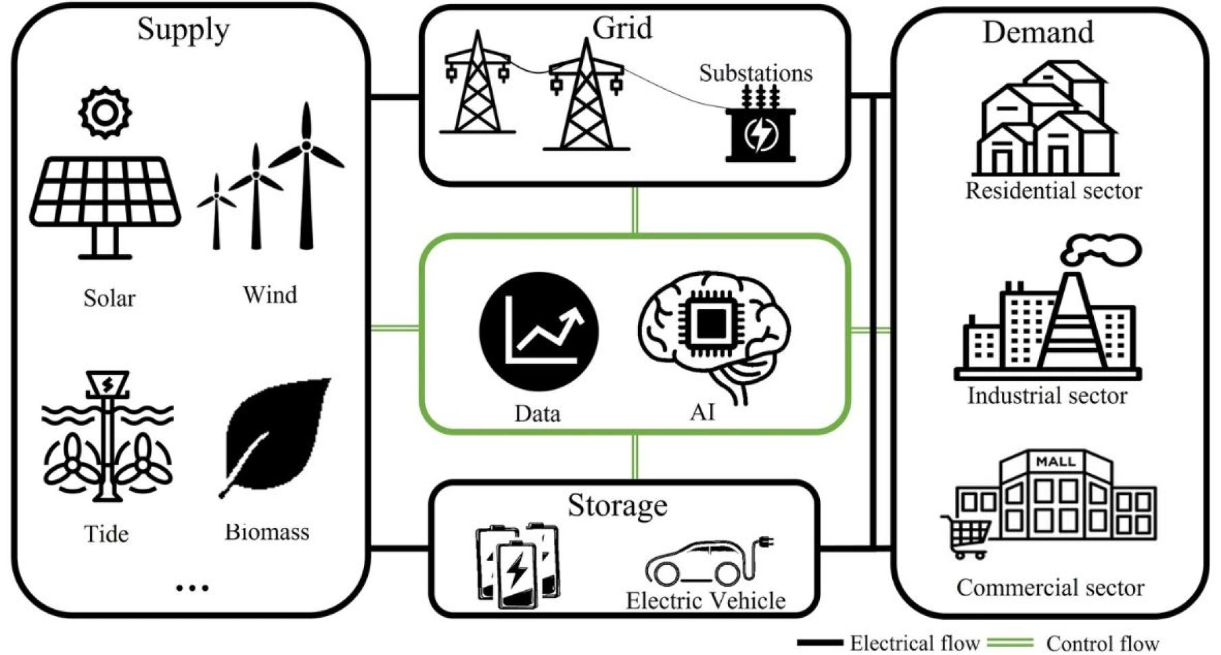
AI-ML Importance of Sustainability
Optimizing Energy Consumption
Smart Grids: AI can predict energy demand and adjust electricity distribution, reducing waste and ensuring that power is available where it's needed most.
Energy Efficiency: ML models analyze how buildings use energy and suggest ways to reduce consumption, such as optimizing heating and cooling systems to lower carbon emissions.
Renewable Energy: AI helps renewable energy systems, like solar panels and wind turbines, by predicting energy production and making sure it’s stored efficiently for when it’s needed.
Image source : https://arxiv.org/html/2406.15732v1
Notes:
Energy is one of the most critical resources, and managing it effectively is essential for sustainability.
Image explanations:
Sustainable energy supply, intelligent energy use, sophisticated grid analytics, mobile and stationary energy storage, and real-time control and management with AI and data at the core are all features of a typical smart grid architecture.
Smart Grids: AI can predict energy demand and adjust electricity distribution, reducing waste and ensuring that power is available where it's needed most.
Energy Efficiency: ML models analyze how buildings use energy and suggest ways to reduce consumption, such as optimizing heating and cooling systems to lower carbon emissions.
Renewable Energy: AI helps renewable energy systems, like solar panels and wind turbines, by predicting energy production and making sure it’s stored efficiently for when it’s needed.

Slide 15

AI-ML Importance of Sustainability
Improving Agricultural Practices
Precision Agriculture: Farmers can use data from drones, sensors, and satellites to monitor soil health, water usage, and crop growth, allowing them to use fewer resources while still getting great results.
Yield Prediction: ML can predict how much food crops will produce, helping farmers plan better and avoid overusing water, fertilizer, and pesticides.
Sustainable Farming: AI helps farmers reduce waste and improve efficiency by optimizing planting schedules and making supply chains more sustainable.
Notes:
Precision Agriculture: Farmers can use data from drones, sensors, and satellites to monitor soil health, water usage, and crop growth, allowing them to use fewer resources while still getting great results.
Yield Prediction: ML can predict how much food crops will produce, helping farmers plan better and avoid overusing water, fertilizer, and pesticides.
Sustainable Farming: AI helps farmers reduce waste and improve efficiency by optimizing planting schedules and making supply chains more sustainable.

Slide 16

AI-ML Importance of Sustainability
Supporting Climate Change Mitigation
Climate Modeling: These technologies process vast amounts of data to improve weather and climate predictions, helping us understand how the climate is changing and what we can do to mitigate its impact.
Carbon Footprint Reduction: By optimizing industrial processes, transportation routes, and energy consumption, ML can help industries reduce their carbon emissions.
Disaster Management: AI can predict natural disasters like floods and wildfires, giving people more time to prepare and minimize environmental and human damage.
Notes:
Climate Modeling: These technologies process vast amounts of data to improve weather and climate predictions, helping us understand how the climate is changing and what we can do to mitigate its impact.
Carbon Footprint Reduction: By optimizing industrial processes, transportation routes, and energy consumption, ML can help industries reduce their carbon emissions.
Disaster Management: AI can predict natural disasters like floods and wildfires, giving people more time to prepare and minimize environmental and human damage.

Slide 17

AI-ML Importance of Sustainability
Enhancing Resource Management
Water Management: AI systems can monitor water quality, predict future demand, and detect leaks in water supply systems, making sure we use this vital resource wisely.
Waste Reduction: ML models optimize recycling processes and promote circular economies, where products are reused or recycled instead of ending up in landfills.
Sustainable Supply Chains: AI makes supply chains more sustainable by reducing energy consumption and waste during transportation and production, while ensuring materials are responsibly sourced.
Notes:
Water Management: AI systems can monitor water quality, predict future demand, and detect leaks in water supply systems, making sure we use this vital resource wisely.
Waste Reduction: ML models optimize recycling processes and promote circular economies, where products are reused or recycled instead of ending up in landfills.
Sustainable Supply Chains: AI makes supply chains more sustainable by reducing energy consumption and waste during transportation and production, while ensuring materials are responsibly sourced.

Slide 18
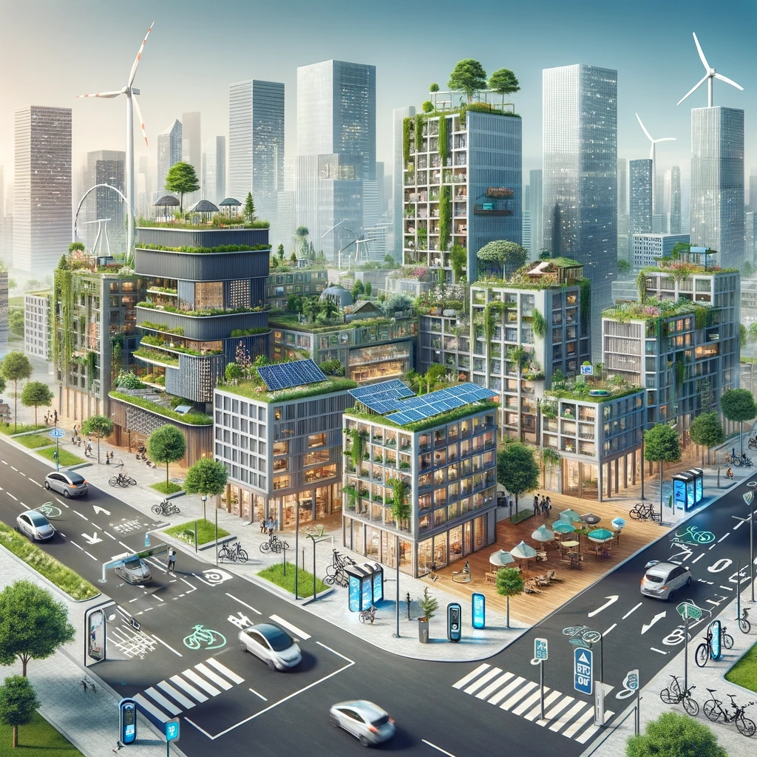
AI-ML Importance of Sustainability
Promoting Sustainable Urban Development
Smart Cities: AI-powered systems can optimize traffic, reduce congestion, and improve public transportation, all of which contribute to better air quality and reduced energy consumption.
Sustainable Infrastructure: ML helps design energy-efficient buildings, reducing waste and ensuring urban environments are more environmentally friendly.
Urban Resilience: By predicting how climate change will affect cities, AI helps urban planners build more resilient and sustainable communities.
Notes:
Smart Cities: AI-powered systems can optimize traffic, reduce congestion, and improve public transportation, all of which contribute to better air quality and reduced energy consumption.
Sustainable Infrastructure: ML helps design energy-efficient buildings, reducing waste and ensuring urban environments are more environmentally friendly.
Urban Resilience: By predicting how climate change will affect cities, AI helps urban planners build more resilient and sustainable communities.

Slide 19

AI-ML Importance of Sustainability
Advancing Environmental Conservation
Wildlife Monitoring: AI systems, using drones and sensors, help track endangered species, protect wildlife from poaching, and monitor animal populations in remote areas.
Forest Management: Machine learning analyzes satellite data to detect deforestation, assess forest health, and guide reforestation efforts, ensuring that forests remain healthy and productive.
Biodiversity Protection: AI helps assess the impact of human activity on ecosystems, providing the insights needed to protect biodiversity and maintain balanced ecosystems.
Notes:
Wildlife Monitoring: AI systems, using drones and sensors, help track endangered species, protect wildlife from poaching, and monitor animal populations in remote areas.
Forest Management: Machine learning analyzes satellite data to detect deforestation, assess forest health, and guide reforestation efforts, ensuring that forests remain healthy and productive.
Biodiversity Protection: AI helps assess the impact of human activity on ecosystems, providing the insights needed to protect biodiversity and maintain balanced ecosystems.

Slide 20
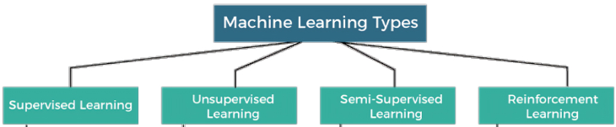
Types of Machine Learning
Within the field of artificial intelligence, machine learning uses statistical models and algorithms to find patterns in data and generate predictions without the need for explicit programming.
Notes:
Types of ML
Supervised Learning
Supervised learning involves training a machine and its algorithm using labeled training data, and requires a significant amount of human guidance. It’s one of the most popular forms of machine learning and is able to train models to accomplish tasks in classification, regression or forecasting.
Unsupervised Learning
With unsupervised learning, raw data that’s neither labeled nor tagged is processed by the system, meaning less work for humans. Unsupervised learning algorithms discover patterns or anomalies in large, unstructured data sets that may otherwise go undetected by humans. This makes it applicable for accomplishing tasks related to clustering or dimensionality reduction.
Semi-Supervised Learning
Semi-supervised learning offers a balanced mix of both supervised and unsupervised learning. With semi-supervised learning, a hybrid approach is taken as small amounts of labeled data are processed alongside larger chunks of raw data. This strategy essentially gives algorithms a head start when it comes to identifying relevant patterns and making accurate predictions when compared with unsupervised learning algorithms, without the time, effort and cost associated with more labor-intensive supervised learning algorithms.
Reinforcement Learning
With reinforcement learning, AI-powered computer software programs are outfitted with sensors, commonly referred to as intelligent agents, that respond to their surrounding environment to make decisions independently that achieve a desired outcome. (Think simulations, computer games and the real world.)

Slide 21
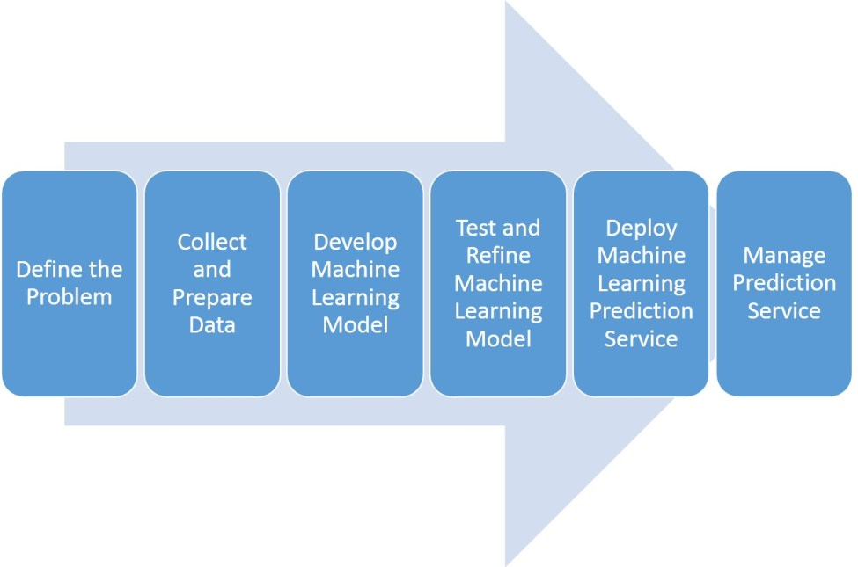
Machine Learning Workflow
Notes:
Define the Problem
When stakeholders come to you with a challenge or issue they wish to resolve, the machine learning pipeline starts. Gathering their requirements is the first thing you should accomplish. The procedure is much the same as what you would do in a normal IT project.
Find out from stakeholders what obstacles they are encountering and what results they anticipate. For instance:
The business problem they need to solve
What is causing it?
The impact on the organization.
What is the desired outcome?
How would they define the success of the project?
How do they intend to use the solution?
Once the problem is well understood, think about the following to see if machine learning is the best option:
The issue is ongoing rather than a passing difficulty.
It is not cost-effective to complete the task by hand.
It can be challenging to build a computer program (coded solution). For instance, when an excessive number of branching business rules are present.
A coded solution could be created, but scalability would be difficult.
Each case determines the prediction result, thus you must customize it.
Over time, the prediction function could alter.
Collect and Prepare Data
A machine learning solution must include data preparation and collecting. In most projects, data collection and preparation represent 80% of the effort. A significant amount of human intervention is needed at this step.
The amount of data required for any given project is not fixed. Three sub-steps comprise data collection and preparation: sourcing, cleansing, and preparation.
Sourcing data involves:
Find the source of all the data necessary for developing the model.
Joining multiple data sources and rationalizing them into one dataset.
Identify features. Features is another name for the attributes of your data.
Analyze data to look for trends.
Common data resources:
data.gov: The U.S. government's open data portal provides access to thousands of datasets across various domains, including health, education, and the economy.
Kaggle: A popular platform for data science competitions, Kaggle hosts a vast repository of datasets across various domains, ranging from finance to healthcare and sports.
UCI Machine Learning Repository: A collection of datasets for machine learning, hosted by the University of California, Irvine, covering numerous application domains.
Google Dataset Search: A search engine that allows users to find datasets stored across the web, making it easy to locate data on specific topics.
OpenStreetMap: A collaborative mapping project that provides free geographic data and mapping to anyone who wants to use it, useful for urban planning and geospatial analysis
National Institutes of Health (NIH): Offers various datasets related to health, genomics, and biomedical research.
The Cancer Genome Atlas (TCGA): A resource that provides genomic data for various cancer types, useful for cancer research and bioinformatics.
Cleaning Data
Databases are prone to have missing or incorrect values. The more time the system has been in service, the worse the problem can be. It is advisable to run quality tests to find missing and inconsistent values.
If you find missing values, there are some actions you can take to clean your data, for example:
Going back to the data source and input the missing values.
Remove rows with missing values.
Replace the missing value with another.
If the missing values are numerical, replace them with the mean or median of the dataset.
Preparing Data
Preparing data involves transforming it into the format best suited for the Machine Learning model.
Tools like Tensorflow and Python have libraries for data preprocessing.
Some examples of data preparation are:
Normalizing numerical data to a standard scale.
Changing data formats.
Simplify redundant data.
Randomize the order of data rows to ensure that data order doesn’t affect the model.
Preparing data also involves splitting the data into two subsets. These are the training data and model evaluation data. We don’t want to use the same data used to develop the model to test it.
Develop a Machine Learning Model
In this step, you develop and train your Machine Learning model:
It means choosing an established Machine Learning technique or defining a new approach.
Python and Tensorflow have extensive libraries with many ML algorithms you can use.
ML Cloud services, like those provided by Microsoft or Amazon, make choosing and using an ML model even more effortless.
You can always develop a new model. However, you often will frame your ML problem into a known one (See step one).
Once you choose a model, you will begin training it. In this step, we use our data to develop our model’s ability to make predictions.
For example, training a supervised learning model would look like this:
You already know the target values you are trying to predict. For instance, if predicting fraudulent transactions, you already know which ones are fraudulent.
Run the model over your training data to predict those values for your training data.
Try different model parameters until the prediction error is below a certain threshold.
Test and Refine the Machine Learning Model
Every learner is at risk of becoming biased. A biased Learner will make great predictions over the training dataset. However, give it a different dataset, and it will underperform.
Testing the learner with a separate dataset is necessary. Here, the “model evaluation” dataset we set aside in Step 2 comes into play.
Consider the following when testing and evaluating the learner:
We can determine if it will perform well in the real world by feeding the model data it has not yet seen.
We work on testing data like we did when training the model. We feed it to the model, then compare its predictions with actual values. As always, we seek an error below a predefined threshold.
During testing, we can change operations and settings (hyperparameter tuning).
Deploy Machine Learning Prediction Service
Deploying the model is a task performed by Machine Learning Engineers. Their job is to turn the ML model into a software component that can receive requests from other applications.
When developing the prediction service, consider the many channels and audiences required. Determine the needs of all software applications that will interact with the service.
In some projects, you could recommend a limited rollout. This trial period will allow business users to work and provide feedback. After the trial, you can deploy the prediction service to a broader audience.
Machine Learning Engineers are experts in the tools to create prediction services. Hire a team of them, and have them develop the best solution that fits your needs.
Production and training data distribution must be similar. Otherwise, the model will make unreliable predictions.

Slide 22
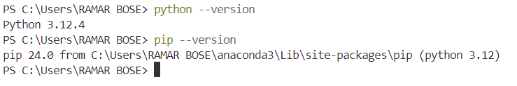
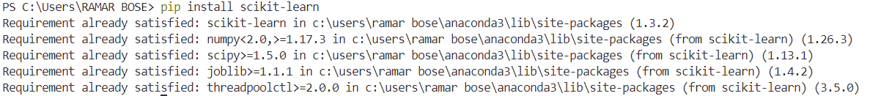
Machine Learning Python Package (Scikit-Learn)
Installation and Setup
You can check your Python and pip versions by running
To install scikit-learn, open a terminal or command prompt / anaconda prompt or juypter notebook and type
Notes:
To install and set up scikit-learn, a widely used Python library for machine learning, first ensure you have Python (version 3.6 or newer) and pip, Python’s package installer.
If you’re using Anaconda, you can install scikit-learn via, “conda install scikit-learn”
This command downloads and installs scikit-learn, along with its dependencies like NumPy, SciPy, and joblib. It’s often recommended to use a virtual environment for your projects to manage dependencies independently.

Slide 23
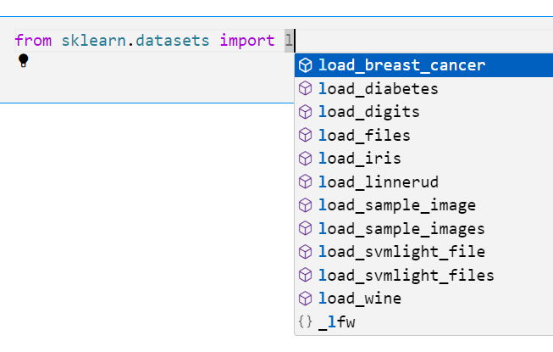
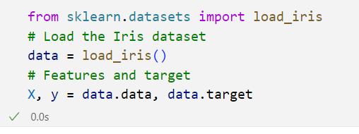
Machine Learning Python Package (Scikit-Learn)
Data Preparation
Notes:
Scikit-learn offers several built-in datasets that are useful for learning and experimenting with machine learning models. These datasets can be easily loaded using functions from sklearn.datasets.

Slide 24
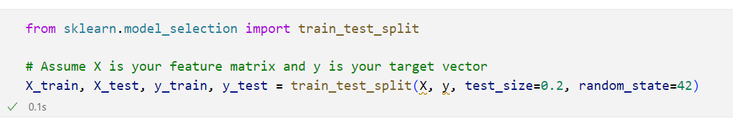
Machine Learning Python Package (Scikit-Learn)
Data Splitting
Parameters:
X: The feature matrix to be split.
y: The target vector to be split.
test_size=0.2: This parameter specifies the proportion of the dataset to include in the test split. In this case, 20% of the data will be reserved for testing, and the remaining 80% will be used for training.
random_state=42: This parameter is used for reproducibility. By providing a specific integer (like 42), you ensure that every time you run your code, you will get the same split of data. If you do not set a random_state, the split will be different each time you run the code, making your results hard to reproduce.
Notes:
The most common way to split data is using train_test_split from scikit-learn’s model_selection module. It splits the dataset into training and testing sets, with a typical split being 80% for training and 20% for testing.
from sklearn.model_selection import train_test_split: This line imports the train_test_split function from the model_selection module of Scikit-learn. This function is used to split datasets into training and testing subsets.
X: This is the feature matrix, which contains the input variables (features) used to predict the target variable. It can be a 2D array or DataFrame where each row represents a sample and each column represents a feature.
y: This is the target vector (or label), which contains the output variable that you want to predict. It can be a 1D array or Series where each entry corresponds to the label of the respective row in X.
Types of splitting,
Stratified Splitting
For classification tasks with imbalanced classes, it’s important to ensure the same class distribution in both training and testing sets. Use stratify=y to split data while preserving the class distribution.
Cross-Validation Splitting
Cross-validation, especially K-Fold Cross-Validation, splits data into K equal parts (folds). The model is trained on K-1 folds and tested on the remaining fold, and this process is repeated K times, ensuring that each fold is used as a test set once.

Slide 25
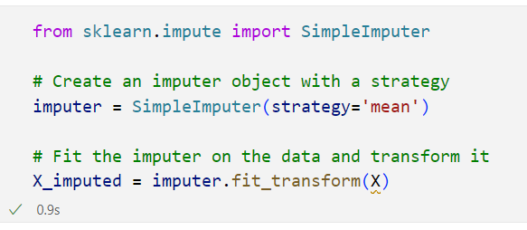
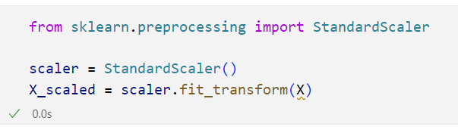
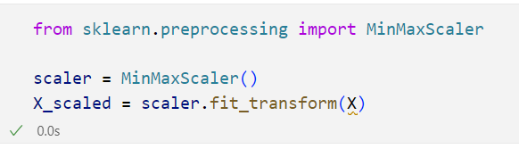
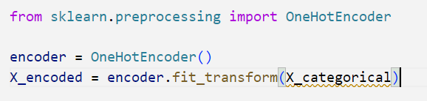
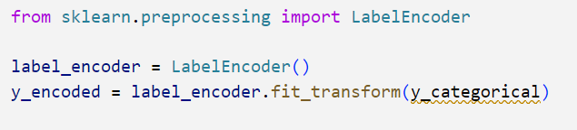
Machine Learning Python Package (Scikit-Learn)
Data Preprocessing
Handling Missing Values
Feature Scaling
Standardization (Z-score normalization)
Min-Max Scaling
Encoding Categorical Variables
Label Encoding for ordinal variables
Notes:
Data preprocessing is a crucial step in the machine learning pipeline that prepares raw data for modeling. It involves cleaning, transforming, and organizing data to improve model accuracy and performance. Scikit-learn offers a variety of tools for effective data preprocessing.
Effective data preprocessing ensures that your data is clean, well-structured, and suitable for modeling. By using the preprocessing capabilities of scikit-learn, you can enhance the accuracy and robustness of your machine learning models.

Slide 26
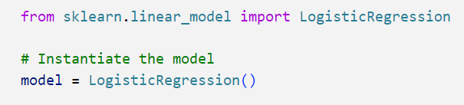
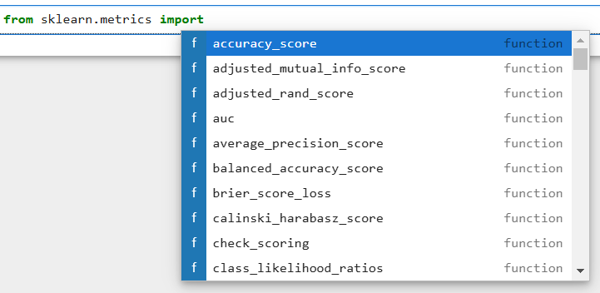
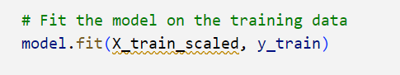
Machine Learning Python Package (Scikit-Learn)
Model Selection
Model Evaluation
Training the Model
Notes:
Model Selection
First, identify whether your problem is a classification, regression, or clustering task.
For instance:
Classification: Logistic Regression, Decision Trees, Random Forest, SVM, etc.
Regression: Linear Regression, Ridge Regression, Random Forest Regressor, etc.
Clustering: K-Means, DBSCAN, Agglomerative Clustering, etc.
Training the Model
Process,
When you call model.fit(X_train_scaled, y_train), the following happens:
The model processes the X_train_scaled data, analyzing the feature values.
It applies the underlying algorithm to learn from the relationship between the features and the target values in y_train.
The model adjusts its internal parameters (weights) based on the training data to minimize the error between its predictions and the actual target values.
Model Evaluation
Model evaluation is a critical step in the machine learning workflow that assesses the performance of a trained model. It involves using various metrics and techniques to determine how well the model generalizes to unseen data. Scikit-learn provides a wide range of tools for evaluating both classification and regression models.

Slide 27
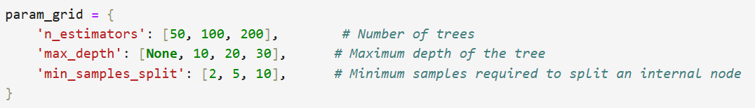
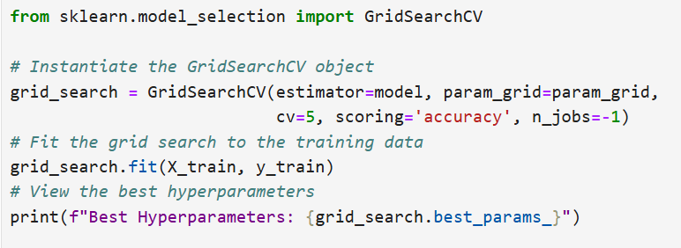
Machine Learning Python Package (Scikit-Learn)
Hyperparameter Tuning
Notes:
Grid Search
Use GridSearchCV to exhaustively search the hyperparameter space. This method evaluates all combinations of the specified hyperparameters using cross-validation.
Hyperparameter tuning is a vital step in building an effective machine learning model. By systematically searching through hyperparameter configurations using Grid Search or Randomized Search in scikit-learn, you can optimize your model’s performance.

Slide 28
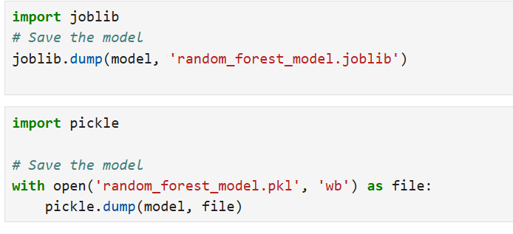
Machine Learning Python Package (Scikit-Learn)
Model Saving and Deployment
Notes:
Saving and deploying a machine learning model is an essential part of the machine learning workflow, allowing you to use your trained model in production without needing to retrain it every time. Scikit-learn makes this process straightforward through serialization, typically using Python’s pickle module or the joblib library.

Slide 29
What is Supervised Learning?
Supervised learning is a type of machine learning in which a model is trained on labelled data, where the input data is paired with the correct output labels.
Supervised learning algorithms learn by analysing a large dataset of labelled examples and adjusting the parameters of the model in order to minimize the error between the model’s predictions and the correct output labels.
Once the model has been trained, it can be used to make predictions on new, unseen data.
Notes:
What is Supervised Learning?
One way to think about supervised learning is to compare it to a student learning from a teacher. In this analogy, the teacher is the labelled data, and the student is the machine learning model. The teacher provides the student with examples of the correct answer (the output label) along with the corresponding input data (e.g. a math problem and the correct solution). The student uses this information to learn how to solve similar problems on their own.
Once the student has learned from the teacher, they can use their knowledge to solve new problems (make predictions on new, unseen data). The teacher can also evaluate the student’s performance by testing them on problems they haven’t seen before (testing the model on a separate dataset). If the student’s performance is satisfactory, they can be considered ready to solve similar problems on their own.
Supervised learning is a type of machine learning in which a model is trained on labelled data in order to learn how to make predictions based on the patterns and relationships in the data

Slide 30
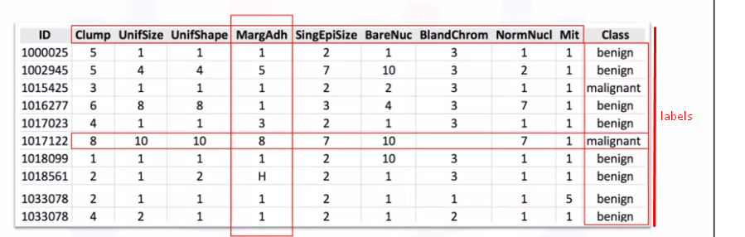
Labeled data
Labelled data,
Used in supervised machine learning
Needs human to label
Expensive, hard and time-consuming to get and store
Used for complex predicting tasks
Notes:
Labeled data
As the name suggests, labeled data (aka annotated data) is when you put meaningful labels, add tags, or assign classes to the raw data that you've collected. What is a label in machine learning? Let’s say you are building an image recognition system and have already collected several thousand photographs. Labels would be telling the AI that the photos contain a ‘person’, a ‘tree’, a ‘car’, and so on.
The machine learning features and labels are assigned by human experts, and the level of needed expertise may vary. In the example above, you don't need highly specialized personnel to label the photos. However, if you have, say, a set of x-rays and need to train the AI to look for tumours, it's likely you will need clinicians to work as data annotators. Naturally, due to the human resources necessary, hand-labelling data is much more expensive than gathering raw unlabelled data.

Slide 31
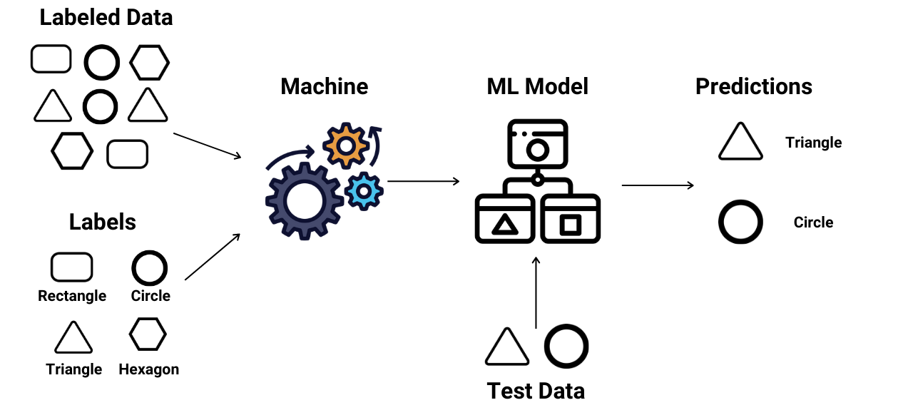
How Supervised Machine Learning Works?
Notes:
How Supervised Machine Learning Works?
Based on the supervised machine learning work flow,
Training Phase: During the training phase, the algorithm is presented with the labelled data. It learns from this data by identifying patterns and relationships between the inputs and outputs.
Model Building: Based on the labelled data, the algorithm builds a model that can generalize from the training examples to make predictions on new, unseen data.
Prediction Phase: Once the model is trained, it can be used to make predictions on new data. The model takes an input, processes it through its learned knowledge, and produces an output prediction.
Supervised learning builds a model that maps inputs to outputs based on labeled training data. The process involves data preparation, model selection, training, evaluation, and tuning. Once complete, the model can predict outcomes for new data with high accuracy, making supervised learning essential for many applications in data science and AI.

Slide 32
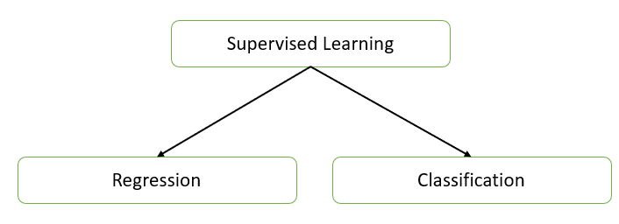
Types of Supervised Learning
There are two primary types of supervised learning,
Regression: Regression tasks involve predicting a continuous numerical value from input data. The output variable in regression is continuous.
Classification: Classification tasks involve predicting a discrete label or category from input data. The output variable in classification is categorical.
Notes:
Types of Supervised Learning
Regression: Regression tasks involve predicting a continuous numerical value from input data. The output variable in regression is continuous.
Classification: Classification tasks involve predicting a discrete label or category from input data. The output variable in classification is categorical.
Supervised learning is a type of machine learning where a model is trained on labeled data, meaning the input data is paired with corresponding output labels. The goal of supervised learning is to learn a mapping from inputs to outputs so that the model can make predictions on unseen data.
Supervised learning encompasses both regression and classification, each serving different purposes based on the nature of the output variable. Understanding the types of supervised learning helps in selecting appropriate algorithms and techniques for specific problems in machine learning.

Slide 33
Supervised Machine Learning Algorithms Implementation steps
Define the Problem
Data Collection and Understanding
Data Preprocessing
Data Splitting
Algorithm Selection
Model Training
Model Evaluation
Model Optimization
Final Model Evaluation on Test Data
Model Deployment
Notes:
Define the Problem
The objective is to identify the problem type (e.g., classification or regression) and define the output variable (target variable).
Decide if data is ready or if it needs to be collected.
Performance Metric is choose the evaluation metrics like accuracy, precision, recall, F1-score (classification), or mean absolute error (MAE), mean squared error (MSE), R-squared (regression).
Data Collection and Understanding
Data Sources is gather the dataset from sources like CSV files, databases, or online repositories.
Exploratory Data Analysis (EDA) need to conduct an initial analysis to understand data distributions, correlations, missing values, and outliers.
Data Preprocessing
Data Cleaning technique is addressing missing values (impute or drop), remove duplicates, handle outliers, and standardize/normalize data.
Feature Encoding is converting categorical variables into numerical formats using methods like one-hot encoding or label encoding.
Feature Scaling is applying scaling techniques like StandardScaler or MinMaxScaler, especially if using algorithms sensitive to data scales (e.g., SVM, KNN).
Feature Engineering is creating new relevant features, transform variables, or combine existing features to add predictive power.
Data Splitting
Split data into training, validation, and test sets. Typical ratios are:
Training: 60-80%
Validation: 10-20%
Testing: 10-20%
Cross-Validation (optional), Use K-fold cross-validation to enhance model evaluation by using multiple subsets of data for training and validation.
Algorithm Selection
Choose an appropriate supervised algorithm based on:
Problem Type: For classification, algorithms include Logistic Regression, SVM, Decision Tree, Random Forest, KNN. For regression, options are Linear Regression, SVR, Decision Tree Regressor, etc.
Data Size and Dimensionality: Certain algorithms (like Random Forest) handle large datasets and high-dimensional data well, while others (like KNN) may struggle.
Model Interpretability vs. Accuracy: For interpretability, simpler models like Linear Regression are better. For higher accuracy, complex models like Neural Networks or Random Forests may be ideal.
Model Training
Initialize the algorithm with default or chosen hyperparameters.
Fit the Model: Use model.fit(X_train, y_train) to train the model on the training data.
Hyperparameter Tuning: Adjust model parameters to improve performance using techniques like:
Grid Search: Searches over specified parameter values exhaustively.
Random Search: Samples random combinations of parameters.
Bayesian Optimization or Automated Machine Learning (AutoML) tools for complex tuning.
Model Evaluation
Training and Validation Scores: Evaluate the model on training and validation data to understand if it is overfitting or underfitting.
Metric Calculation:
Classification: Calculate metrics like accuracy, precision, recall, F1-score, and area under the ROC curve (AUC-ROC).
Regression: Compute metrics such as MAE, MSE, and R-squared score.
Cross-Validation Scores: For more reliable performance assessment, use K-fold cross-validation and check mean and standard deviation of performance metrics.
Model Optimization
Address Underfitting increase model complexity, add more features, or decrease regularization.
Address Overfitting reduce model complexity, use regularization techniques (e.g., Lasso, Ridge), increase training data, or apply dropout (for neural networks).
Feature Selection use feature importance scores to eliminate irrelevant features and improve model generalizability.
Ensemble Techniques for higher accuracy, consider ensemble methods like Bagging (e.g., Random Forest) or Boosting (e.g., XGBoost, AdaBoost).
Final Model Evaluation on Test Data
Evaluate Mode use the test set to get a final, unbiased estimate of model performance.
Error Analysis examine incorrect predictions to identify areas where the model might be improved.
Model Deployment
Save Model use libraries like joblib or pickle in Python to save the model.
Deploy serve the model using frameworks like Flask, FastAPI, or deploy on cloud platforms like AWS SageMaker, Azure ML, or GCP AI.
Monitoring the model’s performance post-deployment and periodically retrain or fine-tune the model as new data arrives.

Slide 34
Regression
In simple terms, regression helps you estimate the relationship between variables. For example, you might want to predict the price of a house based on its size, number of rooms, and location. Here, the house price is the dependent variable, and the other attributes are independent variables.
Notes:
Regression analysis is a statistical method for modeling the relationship between a dependent variable (target) and one or more independent variables (features). It's widely used in predictive analytics, machine learning, and statistics to understand trends, make predictions, and find insights

Slide 35
Regression
Types of Regression
There are various types of regression techniques, each serving specific needs and assumptions:
Simple Linear Regression
Multiple Linear Regression
Polynomial Regression
Logistic Regression
Ridge, Lasso, and Elastic Net Regression
Notes:
Types of Regression
There are various types of regression techniques, each serving specific needs and assumptions:
Simple Linear Regression: Examines the relationship between two variables (one independent and one dependent). It fits a straight line (linear function) to the data.
Multiple Linear Regression: Extends simple linear regression by including multiple independent variables to predict the target variable.
Polynomial Regression: Captures non-linear relationships by using polynomial terms (squared, cubed terms) of the independent variables.
Logistic Regression: Though technically a classification algorithm, it uses regression principles for binary or multi-class classification.
Ridge, Lasso, and Elastic Net Regression: Regularized versions of linear regression that handle multicollinearity and reduce overfitting by adding penalty terms.

Slide 36
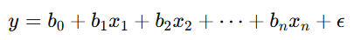
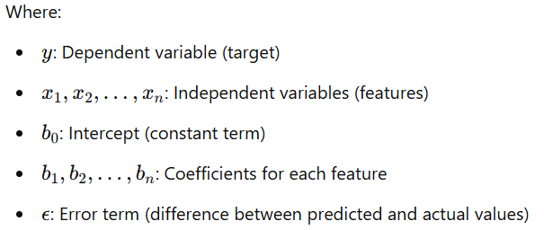
Regression
Mathematics Behind Regression
The general formula for linear regression is
Notes:
Mathematics Behind Regression helps you estimate the relationship between variables. For example, you might want to predict the price of a house based on its size, number of rooms, and location.

Slide 37
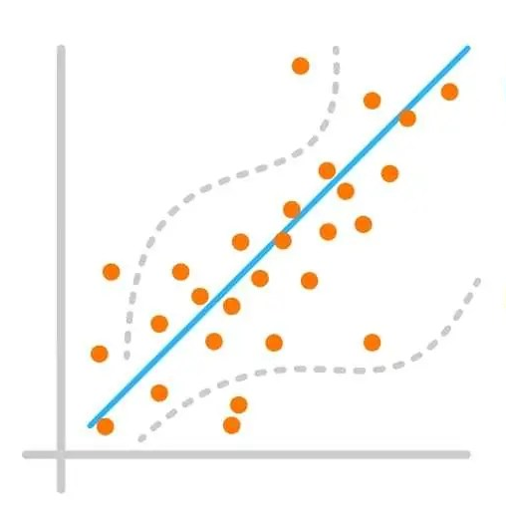
Regression Model Evaluation
Type of Regression Performance Metrics
Mean Absolute Error (MAE)
Mean Squared Error (MSE)
Root Mean Squared Error (RMSE)
R-Squared (R²)
Adjusted R-Squared
Notes:
Regression Model Evaluation
Evaluating regression models is crucial to understanding how well they predict target values. Several metrics provide insights into model accuracy, error distribution, and generalizability.
Type of Regression Performance Metrics
Mean Absolute Error (MAE)
Mean Squared Error (MSE)
Root Mean Squared Error (RMSE)
R-Squared (R²)
Adjusted R-Squared
Evaluating these metrics helps balance model complexity and predictive accuracy, guiding improvements and selecting the best model for the data.

Slide 38
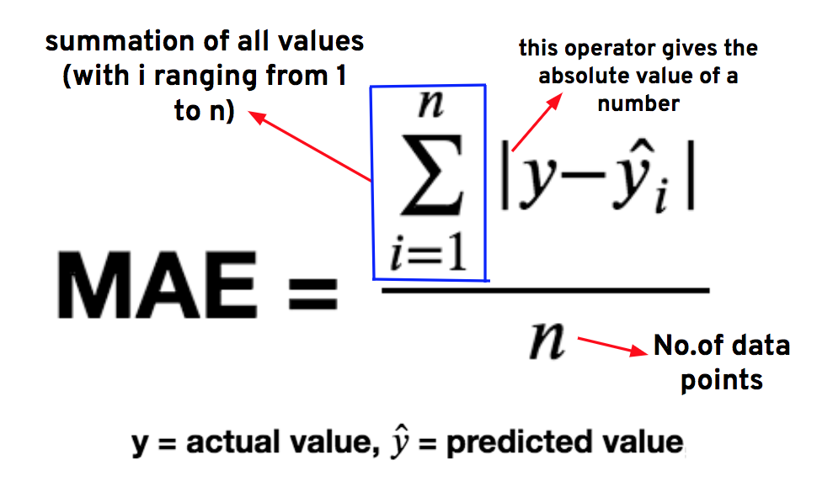
Regression Model Evaluation
Mean Absolute Error (MAE)
Notes:
Mean Absolute Error (MAE) is a widely used metric for evaluating regression models, as it measures the average magnitude of errors between actual values and predicted values without considering their direction. MAE provides an intuitive sense of the average size of errors in the same units as the target variable, making it easy to interpret in real-world applications.
MAE calculates the average of the absolute differences (errors) between each actual and predicted value. By using absolute values, MAE avoids cancelling out positive and negative errors, making it a straightforward measure of prediction accuracy.
Example, MAE is measured in the same units as the target variable, it directly shows the average "distance" between predictions and actual values. For example, if MAE for a house price prediction model is ₹5,000, it means predictions are off by ₹5,000 on average.

Slide 39
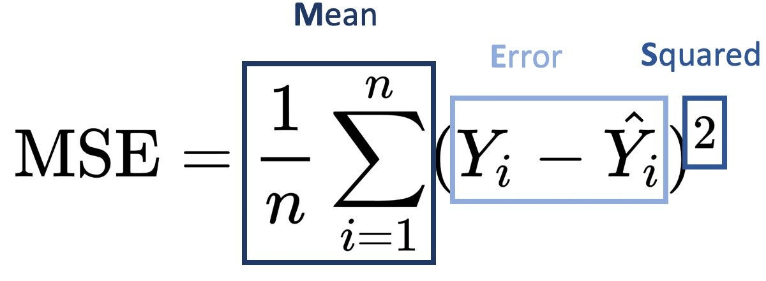
Regression Model Evaluation
Mean Squared Error (MSE)
Notes:
Mean Squared Error (MSE) is a fundamental metric in regression analysis that measures the average squared difference between actual and predicted values. It gives a sense of how far off predictions are from the actual outcomes, providing insight into model accuracy.
Each difference y_{i}​−y_{i}​^ is squared to emphasize larger errors and prevent negative and positive errors from canceling each other out. Squaring the errors also has the effect of penalizing larger errors more heavily, making MSE particularly useful when you want a model to avoid large deviations.
Interpretation of MSE, is a lower MSE indicates that predictions are close to actual values, implying a well-fitting model. However, since MSE is in squared units of the target variable, it can be challenging to interpret in the original units. For this reason, some analysts prefer the Root Mean Squared Error (RMSE), which is the square root of MSE and brings the error back to the original scale.
Note, When comparing multiple regression models, the model with the lower MSE is typically preferred. However, it’s essential to balance this with other metrics (e.g., R-Squared, MAE) and ensure that the model isn’t overfitting to the training data.

Slide 40
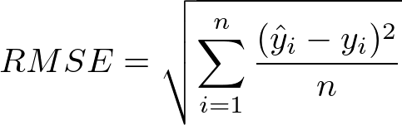
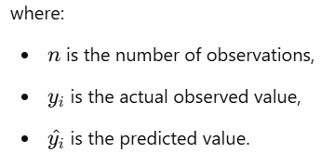
Regression Model Evaluation
Root Mean Squared Error (RMSE)
Root Mean Squared Error (RMSE) is a commonly used metric in regression analysis that measures the average magnitude of error in predictions, expressed in the same units as the target variable. RMSE is calculated by taking the square root of the Mean Squared Error (MSE), which is the average of the squared differences between predicted values (y^) and actual values (y)
Notes:
RMSE is valuable because it penalizes larger errors more than smaller ones. Since it squares the differences, large errors are amplified, making RMSE especially useful when large deviations from actual values are critical. For example, in applications where precise predictions are crucial (like weather forecasting or financial modeling), RMSE helps highlight how far off predictions can be, emphasizing the impact of outliers.
Interpreting RMSE, Since RMSE is expressed in the same units as the dependent variable, it’s directly interpretable. A lower RMSE value indicates better model performance, as it suggests the predictions are closer to actual values. However, RMSE’s interpretation depends on the context of the data and the target variable’s range; what is considered a "good" RMSE can vary greatly. For instance, an RMSE of 10 might be excellent in predicting house prices in millions but inadequate if predicting scores between 0 and 100.

Slide 41
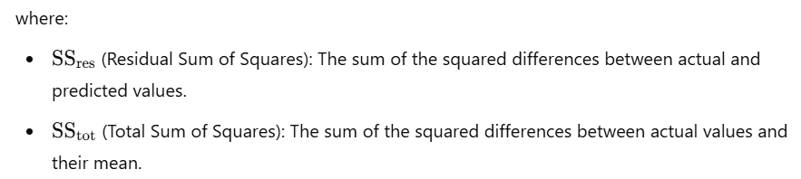
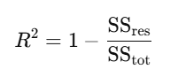
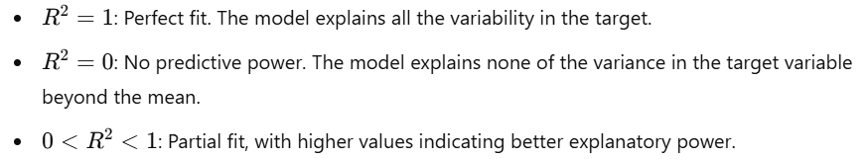
Regression Model Evaluation
R-Squared (R²)
Notes:
R-Squared (R²), also known as the coefficient of determination, is a key metric in regression analysis that measures the proportion of the variance in the dependent variable (target) that can be explained by the independent variables (features). In simpler terms, R² indicates how well the model's predictions align with the actual data points.
By dividing the unexplained variance (SS_{res}​) by the total variance (SS_{tot}​), we get a fraction that indicates how much of the variation in the target variable remains unaccounted for by the model. Subtracting this fraction from 1 yields R², which represents the explained proportion of variance.

Slide 42
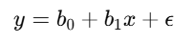
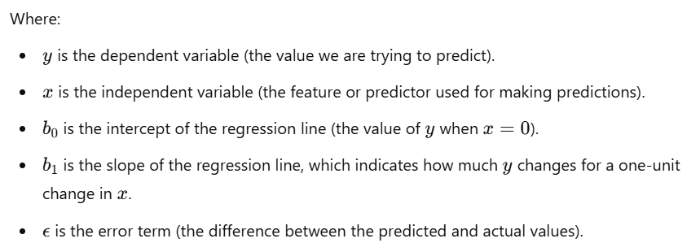
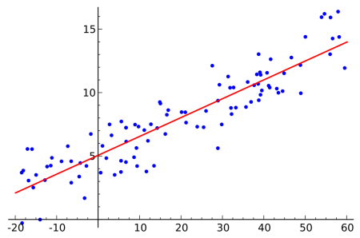
Understanding and Implementation of Simple Linear Regression
Understanding of Simple Linear Regression
The formula for simple linear regression is expressed as:
Notes:
Simple Linear Regression (SLR) is one of the most basic forms of regression analysis, used to model the relationship between two variables. It is a statistical technique that analyzes the relationship between one independent variable (predictor) and one dependent variable (response). The goal is to find the best-fitting straight line that describes this relationship. This line is known as the regression line.
The main objective of SLR is to find the line that best fits the data. This is typically achieved by minimizing the sum of squared residuals (errors). The residual for each data point is the difference between the observed value of y and the predicted value. The line with the smallest sum of squared residuals provides the best model for predicting y based on x.
While simple linear regression is easy to implement and interpret, it has limitations:
It assumes a linear relationship, which may not always be the case. For non-linear relationships, more complex models like polynomial regression might be more appropriate.
It only works with one independent variable. If there are multiple predictors, multiple linear regression is needed.

Slide 43
Understanding and Implementation of Simple Linear Regression
Implementation Simple Linear Regression
Problem Statement
Load Dataset
Data Preprocessing
Define Features and Target
Split the Data into Training and Testing Sets
Create and Train the Simple Linear Regression Model
Make Predictions
Evaluate the Model
Visualize the Results
Save the Model (Optional)
Classroom Hands-on
1. Simple Linear Regression
Notes:
Click Class Room Activity link (then implement and explain the code) Added only SLR if needs MLR you can refer handbook.
To implement Simple Linear Regression for predicting appliance energy consumption, you would follow a typical regression process, where you use features such as temperature, humidity, or time of day to predict energy consumption values.
In this implementation, we used Simple Linear Regression to predict energy consumption based on temperature. By training the model and evaluating its performance using Mean Squared Error and R-Squared, we can assess how well the model fits the data. This method can be extended to include more complex features or used with larger datasets for more robust energy predictions.

Slide 44
Understanding and Implementation of Simple Linear Regression
Understanding of Simple Linear Regression
The formula for simple linear regression is expressed as:
Notes:
Simple Linear Regression (SLR) is one of the most basic forms of regression analysis, used to model the relationship between two variables. It is a statistical technique that analyzes the relationship between one independent variable (predictor) and one dependent variable (response). The goal is to find the best-fitting straight line that describes this relationship. This line is known as the regression line.
The main objective of SLR is to find the line that best fits the data. This is typically achieved by minimizing the sum of squared residuals (errors). The residual for each data point is the difference between the observed value of y and the predicted value. The line with the smallest sum of squared residuals provides the best model for predicting y based on x.
While simple linear regression is easy to implement and interpret, it has limitations:
It assumes a linear relationship, which may not always be the case. For non-linear relationships, more complex models like polynomial regression might be more appropriate.
It only works with one independent variable. If there are multiple predictors, multiple linear regression is needed.

Slide 45

Lab Activity
Hands On
Lab 1
Predicting Solar Power Output Using Linear Regression with MS Excel

Slide 46
What is Unsupervised Learning
Unsupervised learning is a type of machine learning where algorithms analyze and model data without any predefined labels or outputs.
Unlike supervised learning, which uses labeled data to train models, unsupervised learning deals with unlabeled data, exploring patterns, structures, and relationships within the data on its own.
Unsupervised learning techniques include clustering, dimensionality reduction, and anomaly detection.
Notes:
The potential of unsupervised learning in sustainability is vast, as it can continuously learn from large, complex, and unstructured environmental datasets. However, challenges remain, including data quality and interpretability. Green technology applications require robust data preprocessing to handle inconsistencies in ecological and sensor data. Additionally, interpreting unsupervised learning results can be complex, as the lack of labelled data complicates understanding the meaning of identified patterns.

Slide 47
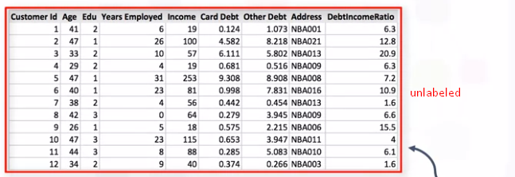
Unlabeled data
Unlabelled data is crucial in advancing the sustainability of green technology, as it provides vast, untapped resources for identifying environmental patterns, improving resource management, and driving innovative eco-friendly solutions.
Notes:
In the context of sustainability, unlabeled data holds significant potential. While labeled data is typically costly and labor-intensive to obtain, unlabeled data can be collected at scale and continuously in real-time. This data comes from numerous sources like satellite imagery, climate sensors, smart meters, and drones, offering up-to-date insights into environmental factors. By leveraging this raw data, machine learning models can identify patterns related to renewable energy, pollution levels, wildlife habitats, and more.
Despite its potential, using unlabeled data presents challenges, especially in sustainability applications. The complexity and volume of environmental data require advanced preprocessing to ensure meaningful results. Additionally, interpreting the patterns detected by unsupervised learning models can be difficult without domain expertise. Addressing these challenges demands interdisciplinary collaboration between data scientists and environmental experts.

Slide 48
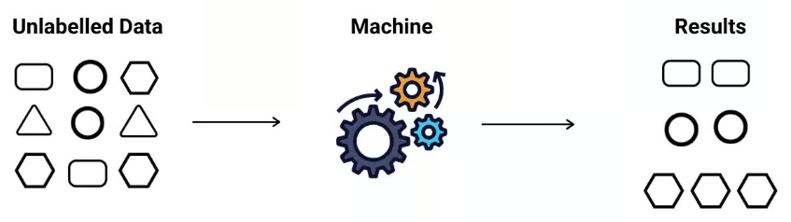
How Unsupervised learning works?
Data Collection and Preparation
Selecting an Unsupervised Learning Algorithm
Pattern Identification
Evaluation and Interpretation
Notes:
Data Collection and Preparation:
Data Collection: The process begins with gathering a large set of unlabeled data. This could include images, sensor readings, text, or other data types that have no associated labels or classifications.
Data Preprocessing: Raw data often requires cleaning and preparation to be useful. Preprocessing can include scaling, normalizing, or transforming the data into a suitable format. For instance, if the data includes numerical values, they may need to be scaled to fall within a specific range for better model performance.
Selecting an Unsupervised Learning Algorithm:
Depending on the objective, different algorithms can be used. The two main types of unsupervised learning tasks are clustering and dimensionality reduction.
Clustering algorithms, like K-Means or Hierarchical Clustering, group similar data points together based on defined similarity measures. This is helpful in applications like customer segmentation.
Dimensionality Reduction techniques, such as Principal Component Analysis (PCA) or t-SNE (t-Distributed Stochastic Neighbor Embedding), simplify data with many variables, which helps in visualizing high-dimensional data and reducing computation time.
Pattern Identification:
The model processes the unlabeled data to find hidden patterns, structures, or groupings. For clustering, this could mean identifying natural groupings among data points based on their attributes. In dimensionality reduction, the model tries to find the most important features in the data, reducing the total number of variables without losing key information.
For instance, in clustering, data points are assigned to clusters based on the distance between them. In K-Means, each data point is assigned to the nearest centroid, which represents the center of a cluster, and the centroids adjust iteratively until they reach an optimal position.
Evaluation and Interpretation:
Since there are no predefined labels, evaluating the quality of an unsupervised model can be challenging. Evaluation techniques like Silhouette Score for clustering (measuring how well-separated the clusters are) or Variance Explained for dimensionality reduction (indicating how much information the reduced data retains) are commonly used.
Interpretation of results is another challenge since patterns are found without any human-defined categories. Experts in the domain are often required to analyze the clusters or components and assign meaning to them.

Slide 49
Types of Unsupervised Learning and Algorithms
Clustering
Clustering is a fundamental technique in unsupervised learning where the algorithm groups data points into clusters based on their similarity. Each cluster ideally represents a group of items with common characteristics, making it particularly useful in areas of green technology where there is a need to categorize vast data efficiently.
Dimensionality Reduction
Dimensionality reduction simplifies high-dimensional datasets by reducing the number of variables while preserving important information. This technique is essential for green technology applications, where datasets can be large and complex—like satellite images, climate datasets, or energy grids.
Notes:
By identifying patterns and structures within raw data, unsupervised learning enables a variety of applications—from environmental monitoring to efficient resource management. In sustainability, two primary types of unsupervised learning, clustering and dimensionality reduction, provide valuable insights by grouping similar data points and simplifying complex datasets, respectively.

Slide 50
Evaluation Techniques
Silhouette Score
Adjusted Rand Index (ARI)
Normalized Mutual Information (NMI)
Notes:
Evaluation techniques such as Silhouette Score, Adjusted Rand Index (ARI), and Normalized Mutual Information (NMI) are essential in assessing the performance of unsupervised learning models, especially for applications in sustainability and green technology. When implementing unsupervised learning algorithms like clustering for sustainable initiatives, these metrics help determine the quality of identified clusters, allowing researchers and policymakers to make data-driven decisions based on meaningful groupings within complex, unlabeled datasets.

Slide 51
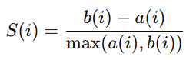
Evaluation Techniques
Silhouette Score
The formula for the Silhouette Score S(i) of a single data point i is,
where:
a(i) is the average distance between point iii and all other points in the same cluster (intra-cluster distance).
b(i) is the minimum average distance from point iii to all points in the nearest neighboring cluster (inter-cluster distance).
The Silhouette Score ranges from -1 to 1:
1: indicates that the data points are well-clustered and far from neighboring clusters.
0: suggests that clusters are overlapping or indistinguishable.
-1: indicates that the clustering is poor, as data points may be assigned to the wrong cluster
Notes:
The Silhouette Score measures the separation distance between clusters, indicating how well each data point lies within its cluster compared to other clusters. This metric is particularly helpful in evaluating clustering for tasks like monitoring pollution hotspots or identifying renewable energy usage patterns.
In sustainability, a high Silhouette Score indicates well-defined clusters for applications like grouping regions by air quality or renewable energy patterns, ensuring effective monitoring and intervention.

Slide 52
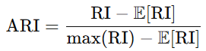
Evaluation Techniques
Adjusted Rand Index (ARI)
The ARI formula is,
where:
RI (Rand Index) counts the agreement between pairs of elements, considering pairs that are either in the same cluster in both clusterings or in different clusters in both.
E[RI] represents the expected RI under a random model.
The ARI ranges from -1 to 1:
1: indicates perfect clustering agreement with ground truth.
0: reflects random labeling.
Negative values indicate worse-than-random labeling.
Notes:
The Adjusted Rand Index (ARI) is a statistical measure that evaluates the similarity between two clustering assignments while adjusting for the chance grouping of elements. ARI is particularly useful for sustainability efforts where the ground truth labels (like manually identified conservation zones) may be compared with machine-generated clusters.
In green technology applications, ARI can assess how well the clusters (e.g., regions with high biodiversity) align with established ecological boundaries, aiding in conservation planning and resource allocation.

Slide 53
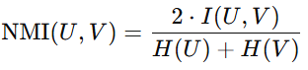
Evaluation Techniques
Normalized Mutual Information (NMI)
The NMI formula is,
where:
U and V are two clustering assignments.
I(U,V) is the mutual information between U and V, measuring the amount of shared information.
H(U) and H(V) are the entropies of U and V, representing the uncertainty in each clustering assignment.
NMI ranges from 0 to 1:
1: indicates a perfect match between the two clusterings.
0: suggests that the clusterings are independent.
Notes:
The Normalized Mutual Information (NMI) measures the mutual dependence between two clustering results, essentially quantifying how much information is shared between the true labels and the predicted clusters. NMI is valuable in sustainability applications where we want to evaluate clusters (e.g., areas of water scarcity or air pollution) against known categories or risk levels.
In sustainability, NMI can be used to compare clusters of air quality zones or renewable energy adoption regions against labeled environmental risk levels, providing insights into environmental trends and intervention areas.

Slide 54
Clustering
What is Clustering?
Clustering involves partitioning a dataset into groups or clusters, where each cluster contains data points that are more similar to each other than to those in other clusters. Similarity is typically measured based on distance metrics, such as Euclidean or Manhattan distance, depending on the data and objective.
Clustering Algorithms
Common clustering algorithms include,
K-Means Clustering
Hierarchical Clustering
Notes:
Clustering is a valuable tool in the sustainability of green technology, transforming raw environmental data into meaningful clusters that aid decision-making. From optimizing energy distribution to conserving biodiversity and improving urban resource management, clustering supports data-driven strategies that promote sustainable growth. As environmental challenges continue to grow, clustering will play a vital role in developing green technology solutions for a sustainable future.
Common clustering algorithms include,
K-Means Clustering: Divides data into a pre-defined number of k clusters by minimizing the distance between data points and the cluster center (centroid).
Hierarchical Clustering: Builds a hierarchy of clusters, merging or splitting clusters iteratively to create a tree-like structure.

Slide 55
Applications of Unsupervised ML Algorithms in sustainability
Energy Consumption Optimization
Algorithms: k-means clustering, PCA, anomaly detection models
Application: Unsupervised models can analyze energy usage patterns across various sectors, such as households, commercial buildings, and industries. By clustering consumers with similar usage behaviors, utilities can design targeted energy-saving programs and offer incentives to high-consumption groups.
Notes:
Impact: Reduces energy waste, optimizes grid performance, and promotes energy efficiency, contributing to reduced greenhouse gas emissions.

Slide 56
Applications of Unsupervised ML Algorithms in sustainability
Waste Management and Recycling Optimization
Algorithms: Image clustering (e.g., using CNNs with k-means or t-SNE), anomaly detection
Application: Unsupervised algorithms assist in sorting waste types by analyzing visual or sensor data from recycling facilities. This helps identify recyclable items from non-recyclables and optimizes waste categorization and processing. Anomaly detection models can also flag unusual or hazardous waste materials that require special handling.
Notes:
Impact: Improves recycling efficiency, reduces landfill waste, and supports circular economy practices by maximizing resource recovery from waste materials.

Slide 57
Applications of Unsupervised ML Algorithms in sustainability
Deforestation Monitoring and Land Use Classification
Algorithms: Clustering, PCA, t-SNE
Application: Satellite and drone imagery data are analyzed with clustering algorithms to classify land cover types and detect deforestation trends. By identifying clusters of deforestation hotspots, conservation efforts can be focused on high-risk areas, and illegal logging can be flagged in real time.
Notes:
Impact: Supports forest conservation, mitigates habitat destruction, and aids in carbon sequestration efforts, which are critical for combating climate change.

Slide 58
Applications of Unsupervised ML Algorithms in sustainability
Water Quality Monitoring and Pollution Detection
Algorithms: Anomaly detection, clustering
Application: Water quality sensors produce continuous streams of data on parameters like pH, temperature, and pollutant concentration. Unsupervised learning algorithms can identify normal water quality patterns and detect anomalies that may indicate pollution events or harmful contamination.
Notes:
Impact: Enhances the safety of water resources, protects ecosystems, and provides early warning for waterborne health risks.

Slide 59
Applications of Unsupervised ML Algorithms in sustainability
Biodiversity Conservation and Species Classification
Algorithms: Clustering, PCA, t-SNE, autoencoders
Application: By analyzing acoustic or visual data from biodiversity monitoring devices, unsupervised algorithms can classify species and detect rare or endangered species based on sound or image patterns. Clustering also helps in understanding migration patterns and habitat utilization by grouping similar species or behaviors.
Notes:
Impact: Supports conservation efforts, monitors biodiversity health, and enables targeted interventions for threatened species or ecosystems.

Slide 60

Conclusion
Learned the historical development and current trends in AI and ML, including their impact across various industries.
Explained the significance of AI and ML in promoting sustainability and addressing environmental challenges.
Understood the differentiate between the main types of machine learning: supervised, unsupervised, semi-supervised, and reinforcement learning.
Understood the outline the essential steps in a machine learning workflow, including data collection, preprocessing, model selection, training, evaluation, and deployment.
Explored and imported and implemented the basic ML models using Scikit-Learn, including linear regression, decision trees, and clustering algorithms.

Slide 61
Reference
Bishop, C. M. (2006). Pattern Recognition and Machine Learning. Springer.
Aggarwal, C. C., & Zhai, C. (2012). Mining Text Data. Springer.
Goodfellow, I., Bengio, Y., & Courville, A. (2016). Deep Learning. MIT Press.
Hartigan, J. A., & Wong, M. A. (1979). "Algorithm AS 136: A k-means clustering algorithm." Journal of the Royal Statistical Society, Series C (Applied Statistics).
Hastie, T., Tibshirani, R., & Friedman, J. (2009). The Elements of Statistical Learning. Springer.
Jain, A. K., Murty, M. N., & Flynn, P. J. (1999). "Data clustering: A review." ACM Computing Surveys, 31(3), 264–323.
Friedman, J., Hastie, T., & Tibshirani, R. (2001). The Elements of Statistical Learning. Springer Series in Statistics.
Notes:
Dear students Here are the references used to create the material for the study purpose only
Good bye everyone have a nice day.
61

Slide 62


Let’s Start

Slide 63


Quiz
Which of the following best describes Artificial Intelligence (AI)?
The simulation of human intelligence by computers
The study of electronic systems and circuits
A branch of physics focused on matter and energy
The programming language used for mobile applications
Answer: a
The simulation of human intelligence by computers

Slide 64
Quiz
2. How does Machine Learning differ from traditional programming?
ML requires more code than traditional programming
ML systems improve automatically with experience, whereas traditional programming requires explicit instructions
ML does not need any programming at all
ML is limited to only numerical data processing
Answer: b
ML systems improve automatically with experience, whereas traditional programming requires explicit instructions

Slide 65
Quiz
3. Which of the following best describes how AI contributes to sustainability?
By creating more jobs in manufacturing industries
By helping in decision-making processes to minimize environmental impact
By increasing energy consumption across all industries
By focusing on traditional manufacturing techniques
Answer: b
By helping in decision-making processes to minimize environmental impact

Slide 66
Quiz
4. How does Machine Learning help in predicting environmental changes?
By manually categorizing environmental data
By analyzing historical data to forecast future environmental patterns
By eliminating the need for data in research
By focusing only on natural resources without considering human activity
Answer: b
By analyzing historical data to forecast future environmental patterns

Slide 67
Quiz
5. What is the first step in a typical Machine Learning workflow?
Model training
Data collection
Model evaluation
Model deployment
Answer: b
Data collection

Slide 68
Thank You
Notes:
Thank You !!

